Slide 1
Chapter 2: Database Design
Database Systems
session 2:
Relational Data Model

Slide 2
Outline
1
Relational Data model
2
ER to Relational Mapping

Slide 3
Relational Database
Basic structure:
  A relational database consists of a collection of tables, each of which is assigned a unique name.
  Tables are also known as Relation.
  The columns in a relation are known as attributes. The order of attributes is insignificant
  A tuple is a row of a relation. They are also called the records.
    Each tuple is unique.
    The order of tuples is insignificant
  Tables are related to each other through some shared attributes.

Slide 4
Relational Database
  The set of allowed values for each attribute is called the domain of the attribute
  Attribute values are (normally) required to be atomic; that is, indivisible
  A null value is a special value that signifies that the value is unknown or does not exist.
  The null value causes complications in the definition of many operations

Slide 5
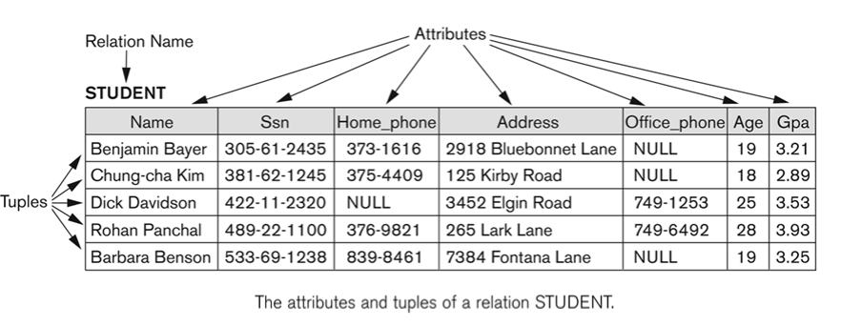
Relational Database
Example: Student Relation

Slide 6
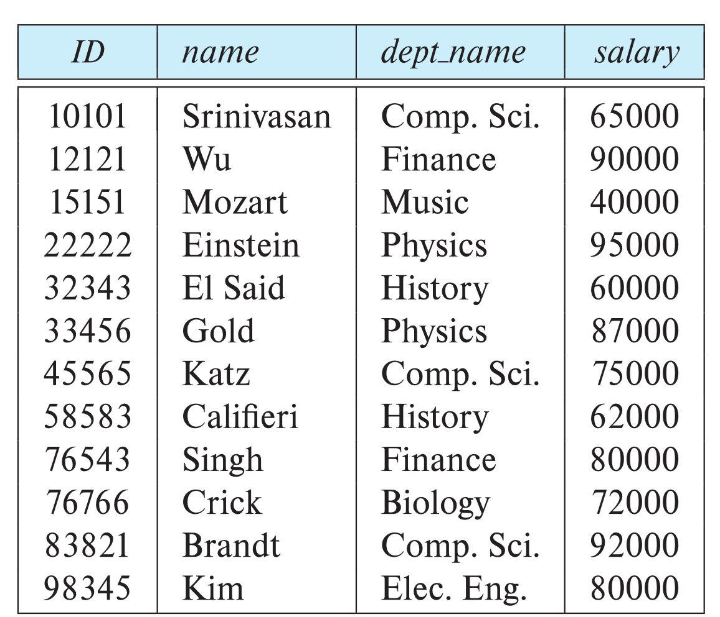
Relational Database
Example: Instructor Relation
attributes
(or columns)
tuples
(or rows)

Slide 7
Relation Scheme
It is a named of a relation defined by a set of attributes and their corresponding domains.
Common convention:
  RelationName (attribute1, attribute2,….,attribute_n)
  The primary key is underlined.
Example:
  Instructor (ID, name, dept_name, salary)
  Branch(branchNo, street, city, postcode)

Slide 8
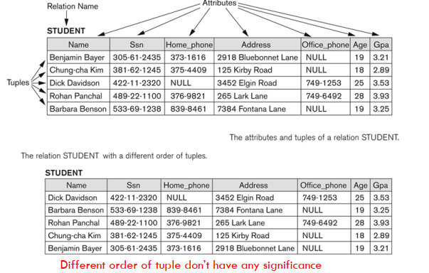
Relation Schema
Characteristics of relation scheme

Slide 9
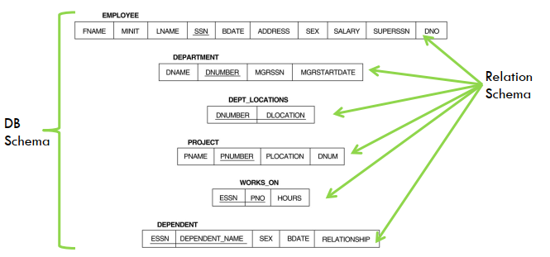
Relational Database Schema
It is a sets of relation schema.
Example: the relational database schema for
COMPANY = {EMPLOYEE, DEPARTMENT, DEPENDENT, PROJECT}

Slide 10
Relational Database Schema
The relation schema normally represented as
follows:
Relation instance
  Is a tuple at a specific moment of time
  Eg: Branch (BranchNo, Street, City, PostalCode )
  The relation instance for branch is:
    (B005, 55 Jln Dobi, Johor Bahru, 80100)
    (B006, 55 Jalan Perai, Johor Bahru, 80000)
  The relation instance change when tuple is updated,
  deleted or inserted.
EMPLOYEE (SSN, FNAME, LNAME, MINIT, BDATE, ADDRESS, SEX, SALARY, SUPERSSN,DNO)
DEPARTMENT (DNUM, DNAME, MGRSSN, MGRSTTDATE)

Slide 11
Relation Keys
Refers to the important attribute in an entity.
Determine the uniqueness of an row in given table.
Identifiers for each rows.
An attribute or more than one attributes can be
declared as keys depending on situations.
Types of keys:
  Superkey
  Candidate Key
  Alternative key
  Primary Key
  Foreign key

Slide 12

Superkey
Superkey is a an attribute, or set of attributes which can uniquely identify a tuple in a relation.
Example: Student( StudentId, firstName, lastName, courseId)
  The super key can be any of the following:
    StudentId
    StudentId, lastName
    StudentId, firstName, lastName
Notes:
Employee( EmpNo, Name, Mobile, Position, Gender, DoB, Salary)
The super key can be any of the following:
EmpNo
EmpNo, Name
EmpNo, Mobile

Slide 13
Candidate Key
A candidate key is a minimal superkey. A superkey that does not contain a subset of attributes that is itself a superkey. This means you cannot remove any fields from candidate key, else it will not be able to uniquely identify the rows.
There can be more than one candidate key in a table
When a key consists of more then one attribute it is known as the composite key
Example: The candidate key for Student relation can be any of the following:
    StudentId
    StudentId, lastName
Notes:
EmpNo
EmpNo, Mobile

Slide 14
Alternative Key
An alternate key is any candidate key that is not primary key.
Alternate keys are sometimes referred as secondary keys
The secondary key is defined as a key that is used strictly for data retrieval purposes

Slide 15
Primary key
A primary key is one of the candidate keys selected to uniquely identify a tuple in a relation.
Which one?
  Primary keys must be chosen with care. Ex: name, SSN, ID,…
  The primary key should be chosen such that its attribute values are never, or are very rarely, changed. Ex: address, mobile,…
Each table must have primary key.
Cannot be NULL value to maintain Entity Integrity.
Example: for Student relation
  StudentId can be chosen to be the primary key
Notes:
MobileNo becomes alternative key

Slide 16
Foreign Key
A foreign key is an attribute (or a set of attributes) whose values match the primary key values in related relation.
  Referencing relation
  Referenced relation
Example
    The attribute courseId is the primary key of Course
    The attribute courseId in Student relation is a foreign key
    Student relation is called referencing relation of the foreign key constraint.
    Course relation is called the referenced relation
Course(courseId, courseName)
Student(StudentId, firstName, lastName, courseId)

Slide 17
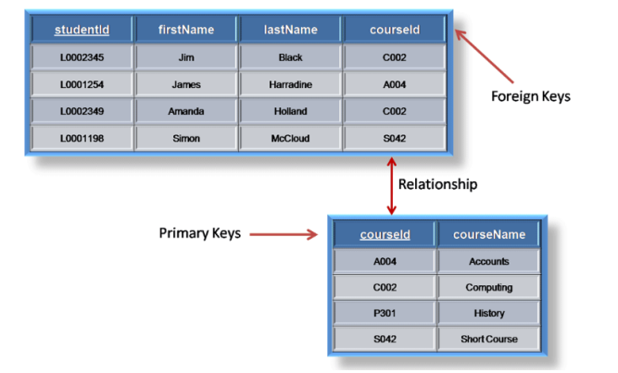
Foreign Key
Example

Slide 18
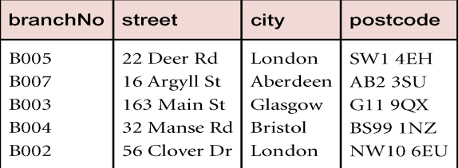
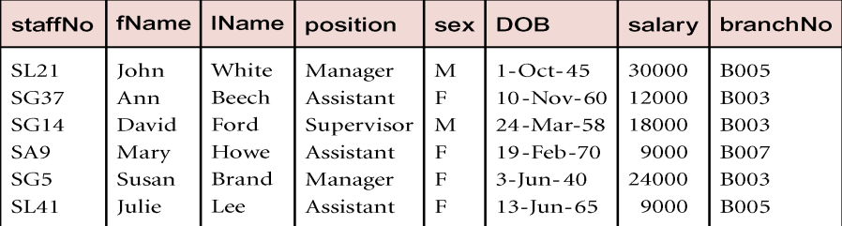
Foreign Key
Another Example
  Branch (branchNo, street, city, postCode)
  Staff (staffNo, fName, lName, position, sex, DOB, salary,
  branchNo)
  Staff has a Foreign Key is branchNo references Branch (branchNo)

Slide 19
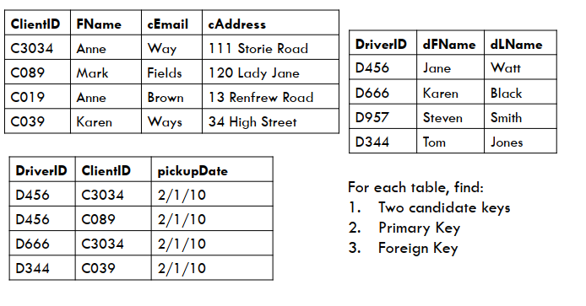
Relation Keys
Group discussion

Slide 20
Integrity rules
To have a good design, a database must have
integrity rules.
Constraint or restriction that apply to all instances of the database.
Integrity rules consists of
  Entity Integrity
  Referential Integrity

Slide 21
Entity Integrity
Requirement
  All Primary Key entries are unique, and no part of a primary key may be NULL.
Purpose
  Each row will have a unique identity, and foreign key values can properly reference primary key values
Example
  In the Employee table, EmpNo is the primary key, it can not have a duplicate number (All employees are UNIQUELY identified by their EmpNo number). And it can not be NULL.
  The OrderDetail has a composite primary key OrderNo and ProductNo so to insert a new row both values must be known.

Slide 22
Entity Integrity
Other integrity rules that can be enforced in the relational model are the NOT NULL and UNIQUE constraints.
  The NOT NULL constraint can be placed on a column to ensure that every row in the table has a value for that column.
  The UNIQUE constraint is a restriction placed on a column to ensure that no duplicate values exist for that column

Slide 23
Referential Integrity
Requirement
  Every non-null foreign key value must reference an existing primary key value in the referenced relation. Or
  The foreign key value can be null.
Purpose
  Makes it possible for an attribute NOT to have a corresponding value, but will be impossible to have an invalid entry.
  The enforcement of the referential integrity rules makes it impossible to delete a row in one table whose primary keys has mandatory matching foreign key values on another table.

Slide 24
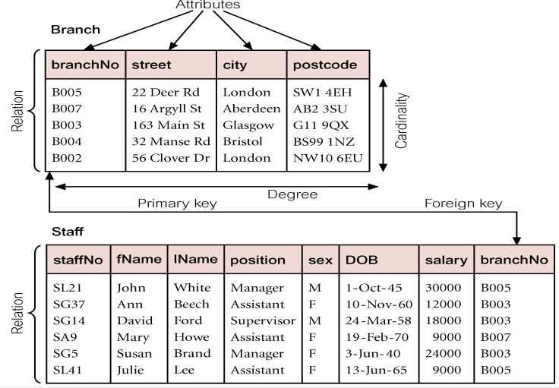
Referential Integrity
Example: Branch and Staff Relation.

Slide 25
Referential Integrity
Example: Branch and Staff Relation.
  It is not possible to create a staff record in Staff Relation with branchNo B025, unless there is already record for branch B025 in Branch relation.
  However, we should be able to create new staff
  record with NULL branch number to allow the situation
  where a new member staff has joined the company but
  has not yet assigned to a particular Branch.

Slide 26
Relationships within the Relational Database
The 1:M relationship is the relational modeling ideal. Therefore, this relationship type should be the norm in any relational database design.
The 1:1 relationship should be rare in any relational database design.
M:N relationships cannot be implemented as such in the relational model. Later in this section, you will see how any M:N relationship can be changed into two 1:M relationships.

Slide 27

1-M Relationship
Example: The ERM’s 1:M relationship between COURSE and CLASS
  Each COURSE can have many CLASSes, but each CLASS references only one COURSE

Slide 28
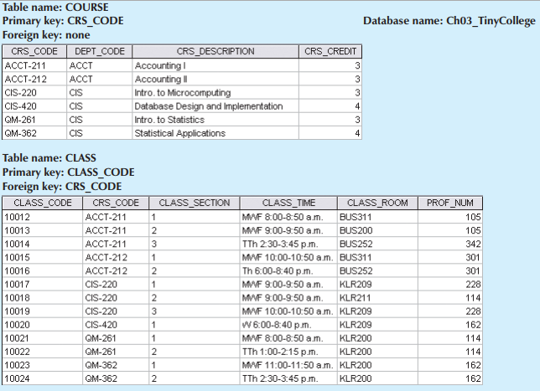
1-M Relationship
The implemented 1:M relationship between PAINTER and PAINTING in relational database

Slide 29

1-1 Relationship
Example: The ERM’s 1:1 relationship between PROFESSOR and DEPARTMENT
  one department chair—a professor—can chair only one department, and one department can have only one department chair.

Slide 30
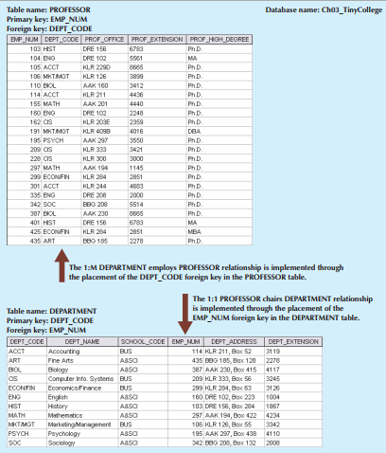
1-1 Relationship
The implemented 1:1 relationship between PROFESSOR and DEPARTMENT in relational database

Slide 31
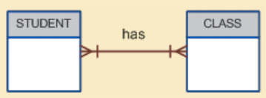
M-N relationship
The ERM’s M:N relationship between STUDENT and CLASS
  Each CLASS can have many STUDENTs, and each
  STUDENT can take many CLASSes.

Slide 32
M-N relationship
The ERM’s M:N relationship between STUDENT and CLASS
  Each CLASS can have many STUDENTs, and each
  STUDENT can take many CLASSes.
In relational database, many-to-many (M:N) relationship can easily be implemented by creating a composite entity (also referred to as a bridge entity or an associative entity).
Notes:
Data Redundancy

Slide 33
M-N relationship
The composite entity structure includes—as foreign
keys—at least the primary keys of the tables that are to be linked.
  The database designer has two main options when
  defining a composite table’s primary key:
    use the combination of those foreign keys or
    create a new primary key
The composite entity is called a linking table when implementing a composite entity in relational database.

Slide 34
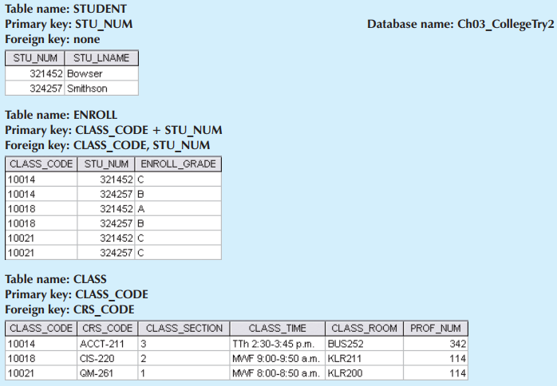
M-N relationship
Converting the M:N relationship into two 1:M relationships

Slide 35
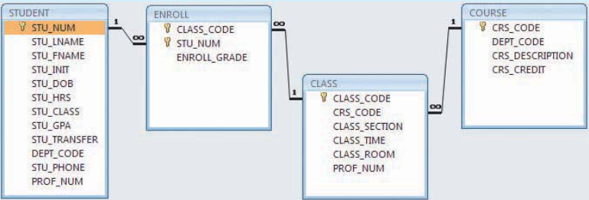
Relationships within the Relational Database
The relational diagram for the Ch03_TinyCollege database

Slide 36
ER Model to Relational mapping
Mapping ERM (Entity Relationship Model) to Relation
  Step 1: Mapping of Regular Entity Types
  Step 2: Mapping of Weak Entity Types
  Step 3: Mapping of Binary 1:1 Relationship Types
  Step 4: Mapping of Binary 1:N Relationship Types
  Step 5: Mapping of Binary M:N Relationship Types
  Step 6: Mapping Unary Relationship Types
  Step 7: Mapping of Multivalued attributes
  Step 8: Mapping of n-ary Relationship Types
  Step 9: Mapping Supertype/Subtype Relationships

Slide 37
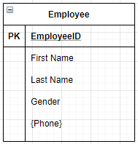
Step 1: Mapping strong/regular Entity
For each strong/regular entity, create a relation that includes all the simple attributes
Primary key of the entity becomes the primary key of the relation.
Exclude multivalued attribute from the mapping relation.
Example:
Employee(EmployeeID, FirstName, LastName, Gender)
Note: Phone is a multivalued attribute.

Slide 38
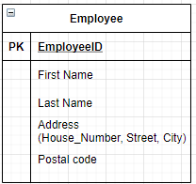
Step 1: Mapping strong/regular Entity
When a regular entity type has a composite attribute, only the simple components of the composite attribute are included in the new relation as its attributes
Example:
Employee(EmployeeID, FirstName, LastName, House_Number, Street, City, PostalCode)

Slide 39
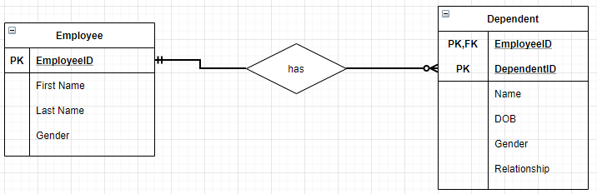
Step 2: Mapping of Weak Entity
Create separate relation and include all simple attributes
The primary key of the relation is the combination of all the primary key attributes from the owner and the partial key of the weak entity, if any
=> Dependent(EmployeeID, DependentID, Name, DOB, Gender, Relationship)
Employee(EmployeeID, FirstName, LastName, Gender)

Slide 40
Step 3: Mapping Binary 1:1 relationship
Step 3: Mapping Binary 1:1 relationship
Before tackling a 1:1 relationship, we need to know its optionality.
There are three possibilities the relationship can be:
1. mandatory at both ends
2. mandatory at one end and optional at the other
3. optional at both ends

Slide 41
Step 3: Mapping Binary 1:1 relationship
1. Mandatory at both ends
Combine two entity into one when the relationship is mandatory at both ends.
  The choice of which entity type subsumes the other depends on which is the most important entity type (more attributes, better key, semantic nature of them).
  The key of the subsumed entity type becomes a normal attribute
When not to combine a 1:1 mandatory relationship:
  the two entity types represent different entities in the ‘real world’.
  the entities participate in very different relationships with other entities.
  efficiency considerations when fast responses are required or different patterns of updating occur to the two different entity types
  => The primary key of one entity type comes the foreign key in the other.

Slide 42
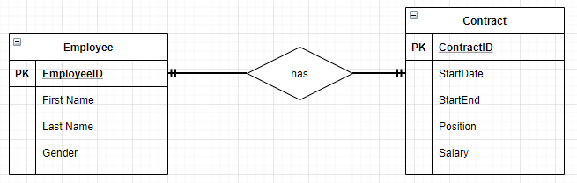
Step 3: Mapping Binary 1:1 relationship
Example: Two entity types; employee and contract.
  Each member of employee must have one contract and each contract must have one member of employee associated with it.
  It is therefore a mandatory relations at both ends.

Slide 43
Step 3: Mapping Binary 1:1 relationship
3 options to mapping:
  Combine two entity into one.
Employee(EmployeeID, FirstName, LastName, Gender, ContractID, StartDate, StartEnd, Position, Salary)
or kept apart and a foreign key used
Employee(EmployeeID, FirstName, LastName, Gender, ContractID)
Contract(ContractID, StartDate, StartEnd, Position, Salary)
or
  Employee(EmployeeID, FirstName, LastName, Gender)
  Contract(ContractID, StartDate, StartEnd, Position, Salary, EmployeeID)

Slide 44
Step 3: Mapping Binary 1:1 relationship
2. Mandatory at one end and optional at the other
Take the primary key from the ‘mandatory end’ and add it to the ‘optional end’ as a foreign key.
The entity type of the optional end may be subsumed into the mandatory end as in the previous example.
It is better NOT to subsume the mandatory end into the optional end as this will create null entries.
Given entity types A and B, where A, B is in a relationship where the A end it optional, the result would be:
A (primary key,attribute,...,foreign key to B)
B (primary key,attribute,...)

Slide 45
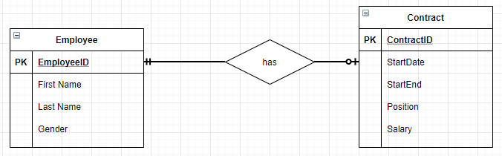
Step 3: Mapping Binary 1:1 relationship
2. Mandatory at one end and optional at the other
Example: Contract is optional (each employee may have at most one contract)
  => Employee(EmployeeID, FirstName, LastName, Gender)
  => Contract(ContractID, StartDate, StartEnd, Position, Salary, EmployeeID)
Notes:
Map the foreign key into Staff - the key is null for staff without a contract.
Staff(emp_no, name, contract_no)
Contract(cont_no, start, end, position, salary)
Map the foreign key into Contract - emp_no is mandatory thus never null.
Staff(emp_no, name)
Contract(cont_no, start, end, position, salary, emp_no)

Slide 46
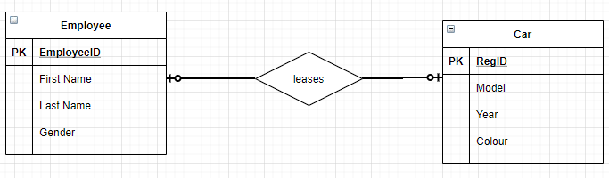
Step 3: Mapping Binary 1:1 relationship
2. Optional at both ends
Use a foreign key approach.
Example: Each staff member may lease up to one car, Each car may be leased by at most one member of staff
  =>Can not combine two entity into one.
  Employee(EmployeeID, FirstName, LastName, Gender)
  Car(RegID, Model, Year, Colour, EmployeeID)
Notes:
Each staff member may lease up to one car
Each car may be leased by at most one member of staff
If these were combined together...
Staff_car(emp_no, name, reg_no, year, make, type, colour)
what would be the primary key?
If emp_no is used then all the cars which are not being leased will not have a key.
Similarly, if the reg_no is used, all the staff not leasing a car will not have a key.
A compound key will not work either.

Slide 47
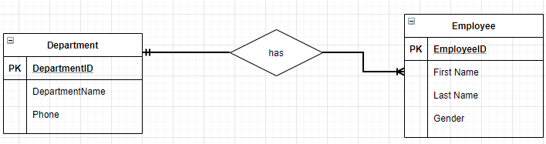
Step 4: Mapping Binary 1:M relationship
The primary key on the ‘one side’ of the relationship is added to the ‘many side’ as a foreign key.
Example:
  => Department(DepartmentID, DempartmentName, Phone)
  => Employee(EmployeeID, FirstName, LastName, Gender, DepartmentID)

Slide 48
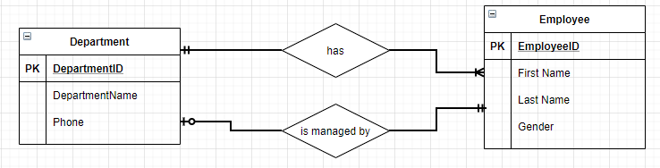
Step 4: Mapping Binary 1:M relationship
Parallel relationships occur when there are two or more relationships between two entity types
Example:
In order to distinguish between the two roles we can give the foreign keys different names.
=>Employee(EmployeeID, FirstName, LastName, Gender, DepartmentID)
=>Department(DepartmentID, DepartmentName, ManagerID)

Slide 49
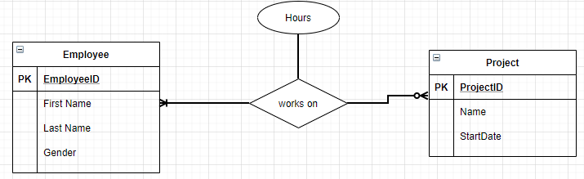
Step 5: Mapping Binary M:N relationship
Create a new relation containing the primary keys of both participating entity types and descriptive attribute (if any)
These primary keys form a composite primary key of the new relation.
=> WorksOn(EmployeeID, ProjectID, Hours)

Slide 50
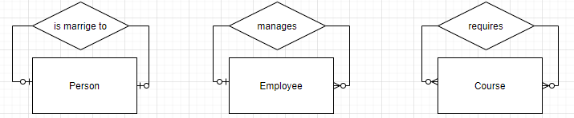
Step 6: Mapping Unary relationship
Unary relationships (or recursive relationships) is one in which a relationship can exist between occurrences of the same entity set.
Example:
1-1 relationship
1-M relationship
M-N relationship

Slide 51
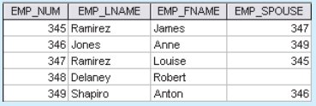
Step 6: Mapping Unary relationship
Mapping the 1:1 unary relationship “EMPLOYEE is married to EMPLOYEE”
=> Employee( EmpNum, Emp_Lname, Emp_Fname, Emp_Spouse)
Implementation
=>The foreign key is the primary key of the same table, but is given a different name.

Slide 52
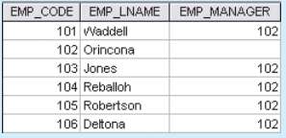
Step 6: Mapping Unary relationship
Mapping the 1:M unary relationship “EMPLOYEE manages EMPLOYEE”
=> Employee( Emp_Code, Emp_Lname, Emp_Manager)
Implementation
=>The foreign key is the primary key of the same table, but is given a different name.
Notes:
the relationship is optional in both directions because not all staff can be managers, and the top manager is not managed by anybody else.

Slide 53
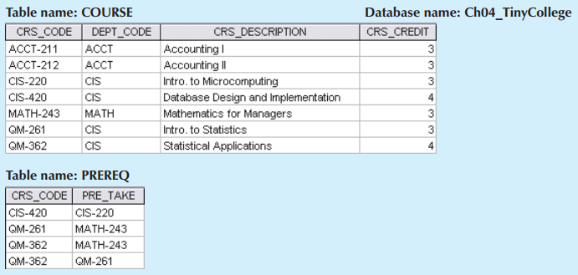
Step 6: Mapping Unary relationship
Mapping the M-N unary relationship “COURSE requires COURSE”
=> Course( Crs_code, Dept_code, Crs_Description, Crs_credit)
=> PreReq( Crs_code, Pre_Take)
Notes:
A COURSE may be a prerequisite to many other COURSEs, and each COURSE may have many other COURSEs as prerequisites.
Another the M:N recursive relationship “PART contains PART”
PART(PNUMBER, DESCRIPTION, ...)
COMPRISE( MAJOR-PNUMBER, MINOR-PNUMBER, QUANTITY)

Slide 54
Step 7: Mapping Multivalued Attributes
Create a new relation R for each multivalued attribute
Add primary key of the original entity to the new relation R as a foreign key.
The primary key of R is the combination of R and the original entity. If the multivalued attribute is composite, we include its simple components.
=> Phone(EmployeeID, PhoneNumber, type)
=>Employee(EmployeeID, FirstName, LastName, Gender)

Slide 55
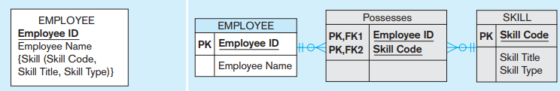
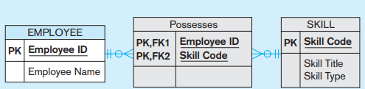
Step 7: Mapping Multivalued Attributes
Another example: In ER model
In the relation shema:
=>Skill(SkillCode, Skill Title, Skill Type)
=>Possesses(EmployeeID, SkillCode)
=>Employee(EmployeeID, EmployeeName)

Slide 56
Step 8: Mapping n-ary Relationship types
Mapping Ternary (and n-ary) relationship type:
  One relation for each entity and one for the associative entity
  Associative entity has foreign keys to each entity in the relationship

Slide 57
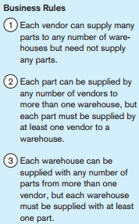
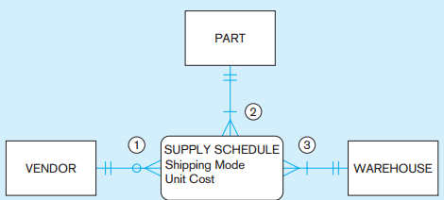
Step 8: Mapping n-nary Relationship types
Example
In relational schema
=>Vendor( VendorID,…)
=>Warehouse(WareHouseID,…)
=>Part(PartID,…)
=>Supply(VendorID, WareHouseID, PartID, shippingMode, UnitCode)

Slide 58
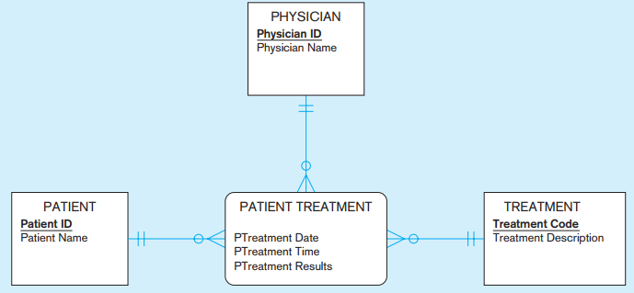
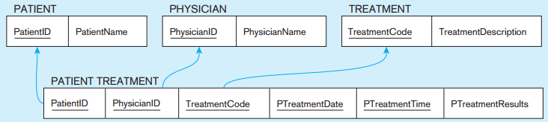
Step 8: Mapping n-nary Relationship types
Another example:
In relational schema

Slide 59
Mapping Supertype/Subtype Relationships
One relation for supertype and for each subtype
Supertype attributes (including identifier and subtype discriminator) go into supertype relation
Subtype attributes go into each subtype; primary key of supertype relation also becomes primary key of subtype relation
1:1 relationship established between supertype and each subtype, with supertype as primary table

Slide 60
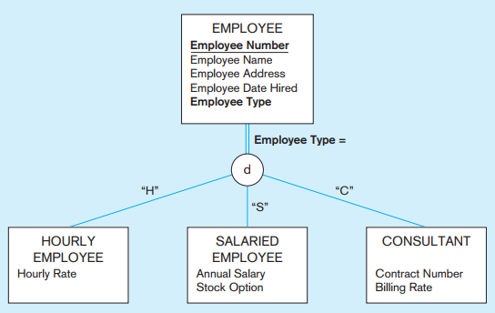
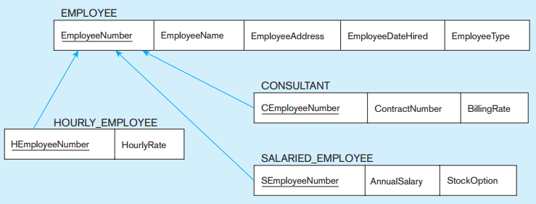
Mapping Supertype/Subtype Relationships
Example
Mapping
Notes:
SELECT *
FROM Employee_T, SalariedEmployee_T
WHERE EmployeeNumber = SEmployeeNumber;

Slide 61
Thank You !

